Slide 1
Marketing Analytics
Session 4
Data vizualisation

Slide 2
Agenda
Introduction to ggplot2
The grammar of graphics
Examples

Slide 3
GGPLOT2
An overview

Slide 4
ggplot2
ggplot2 is a very powerful graphic library
Written by Hadley Wickham
Inspired by the "grammar of graphics" (Leiland Wilkinson)
A graphic has many moving parts
Data, geometries, aesthetic mapping, etc.
Each element has to be specified separately

Slide 5
"Grammar of graphics" in a nutshell
Data
The information you want to plot
Geometries
Visual elements you can see in the plot itself
Points, lines, bars, etc.
Aesthetics
Graphical properties that encode the data on the chart
Coordinates, shape, color, size, etc.
But also…
Statistical transformation, Scale, Facet, Coordinate system, etc.

Slide 6
Structure of a ggplot object
ggplot(data = <default data set>,
aes(x = <default x axis variable>,
y = <default y axis variable>,
... <other default aesthetic mappings>),
... <other plot defaults>) +
geom_<geom type>(aes(size = <size variable for this geom>,
... <other aesthetic mappings>),
data = <data for this point geom>,
stat = <statistic string or function>,
position = <position string or function>,
color = <"fixed color specification">,
<other arguments, possibly passed to the _stat_ function) +
scale_<aesthetic>_<type>(name = <"scale label">,
breaks = <where to put tick marks>,
labels = <labels for tick marks>,
... <other options for the scale>) +
theme(plot.background = element_rect(fill = "gray"),
... <other theme elements>)

Slide 7
Geometries
Different types of geometries
Points geom_point()
Lines geom_line()
Bars geom_bar
Boxplot geom_bloxplot()
Etc.
At least one geom per plot
As many as you want
Add a geom using the + operator
Get the list of geom with
help.search("geom_", package = "ggplot2")

Slide 8
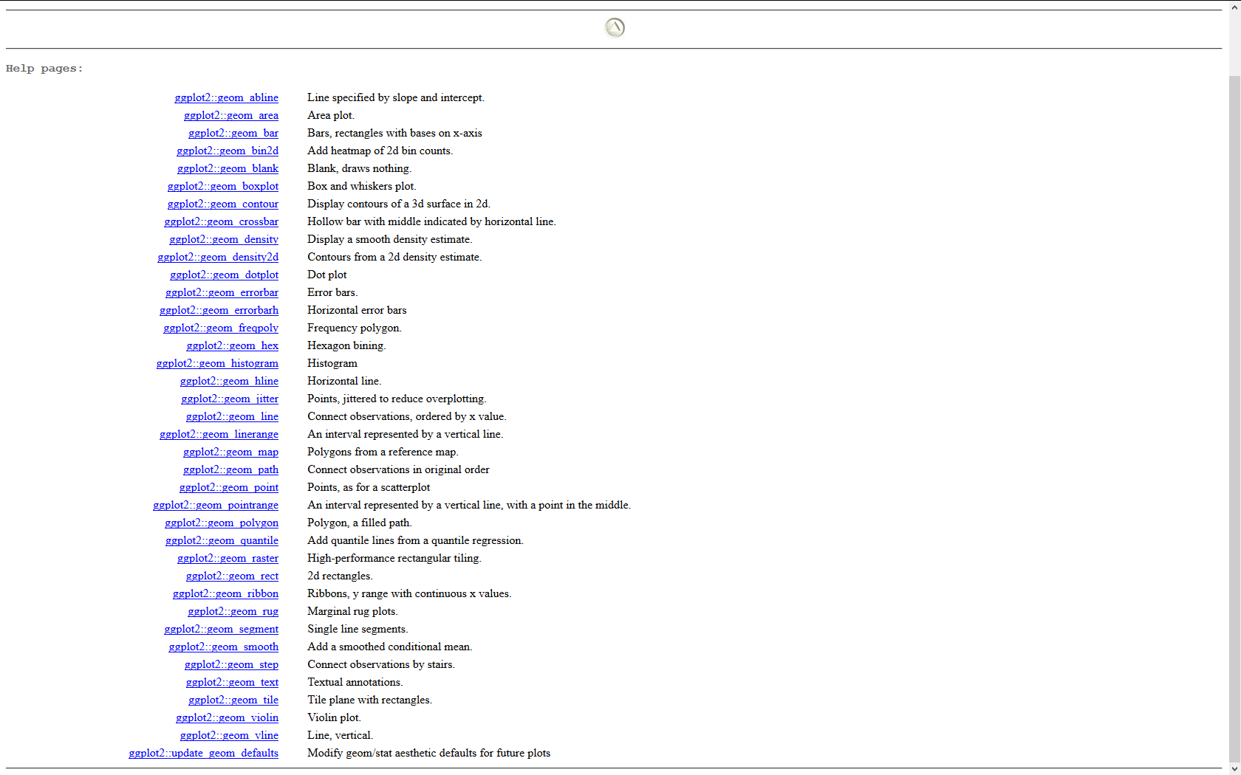

Slide 9
Aesthetics
aesthetic = "something you can see"
It's the visual translation of your data
Examples:
Position (i.e., on the x and y axes)
Color ("outside" color)
Fill ("inside" color)
Shape (of points)
Linetype
Size
Etc.
Not all aesthetics are compatible with all geoms

Slide 10
Aesthetics: positions or coordinates
Gender
(male / female)
Age
(integer)

Slide 11
Aesthetics: shape
Gender
(male / female)
Age
(integer)

Slide 12
Aesthetics: color
Gender
(male / female)
Age
(integer)

Slide 13
Aesthetics: size
Gender
(male / female)
Age
(integer)

Slide 14
Examples
Graphics_1.R
Basic notions
Graphics_2.R
Working with factors
Graphics_3.R
Preparing data for complex plotting
Graphics_4.R
Preparing data for complex plotting + using facets

Slide 15
That’s all folks !

